Slide 2
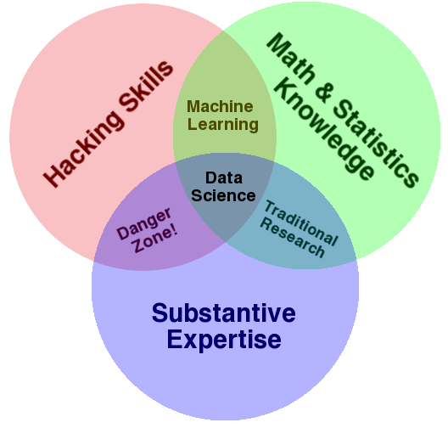
What is Data Science?
Multi disciplinary field
Use of tools for analysing raw data to discover any hidden patterns
Solving problems with data

Slide 3
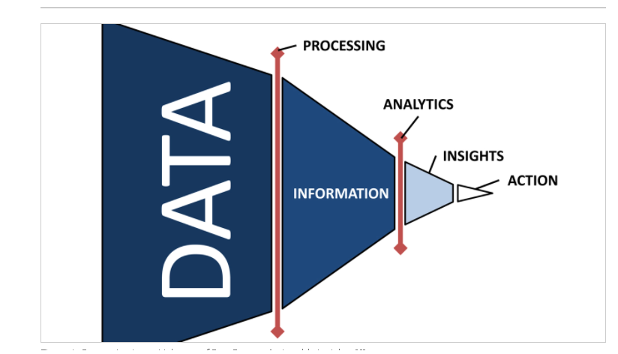
Need of data science in railways
To calculate the state of health of rail network
To identify critical areas in system and subsystem
To optimise network renovation
For passenger safety
To calculate predictive maintenance
To ensure dynamic and robust project performance

Slide 4
What data science do
Many systems in railway traffic control need large amount of data to be handled to give information or manage traffic
Helps to predict train traffic flow in real time
Helps to learn the riders journey patterns in the transportation network, which can be used for better public transportation service planning
Helps to increase safety level in railways

Slide 5
Train delay prediction
Many times trains are delayed
Factors affecting train timings are:
Weather conditions
Track conditions
Riots, strikes, rallies, etc
Data analysis is done from following data collected:
Historical train delay data
Weather forecasting data
Notes:
As we know that many times train don’t reach on time this creates a lot of mess with different trains as well as creates difficulty for passengers so in order to control train traffic it is necessary to predict the train delays and manage signals as well train departures and arrivals for other trains. Generally this delays of trains occur due to weather conditiond or track conditions or sometimes riots, strikes , rallies, etc

Slide 6
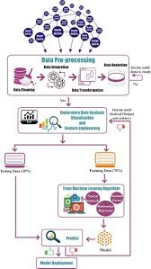
Train delay prediction process
Historical data for train delays is collected
Weather data is collected
Exploratory data analysis is done
Feature engineering to decide algorithms
Algorithms that are generally used:
Extreme learning machine
Random forest
Whole data set divided into training and testing data set
Functions are produced to map new values

Slide 7
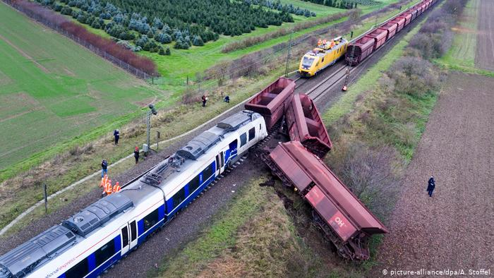
Data Science In Train Accident Prevention
Data Science, being a master of data analysis and prediction of given parameters or units, can also be used as a life-saving measure by the railway industry.
This decisive field can be used to prevent accidents of trains, which involves immediate course of action, insightful thinking and also, some critical calculations.
As we know, data science can keep track of the train speed and object distance, it can prove vital in train accident close-calls.

Slide 8
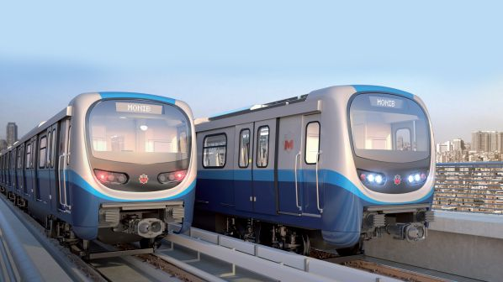
Like, if we consider an example of two trains travelling in the same direction, the trains’ speeds can be kept in account and the fact that they are at a safe distance from each other.
If at all, the working of Train 1, which is ahead on the tracks, stops due to technical failure, the Train 2’s distance is taken into account and time also plays a pivotal role if the Train 2 is not at a safe distance from Train 1.
Parameters like time , train speed, braking efficiency, frictional control, distance, and many more are taken into consideration for crucial and at the same time quick decisions for stopping of fatal accidents.

Slide 9
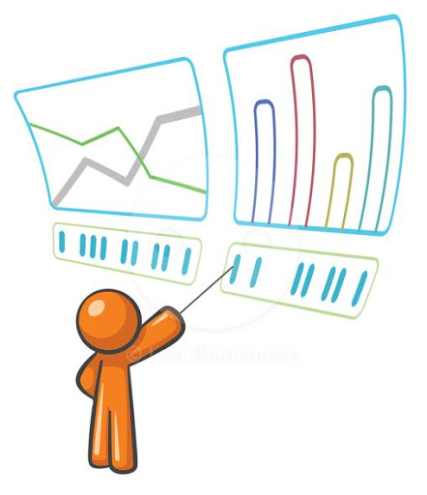
If the on-the-spot analysis of graphical data and actions like sudden braking or immediate lowering of speed are performed right away.
This can actually prevent the causing of an actual accident at the meeting point of two trains.
If it is too late for the latter train to brake before it appears at the rear point of the former, a fully calculated track change action can also prove useful for the prevention of a devastating fatality.

Slide 10
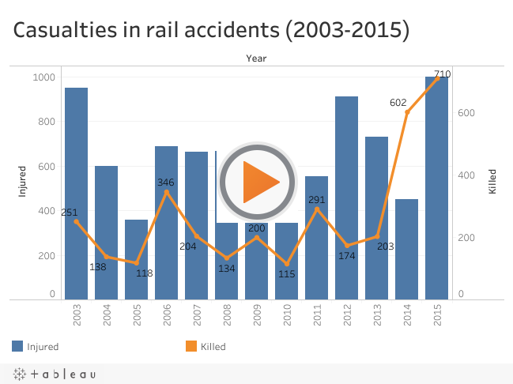
This is how Data Science can prove to be useful in railway accident control.
If we think of a more suggestive and analytical data tools to be put in the working of such operations, we can think of using charts and graphs for tracking death rate of population with suggestive measures for the prevention of deaths.
If possible, we can also set particular range of speeds for each and every train travelling from one place to the other.
So, even if a train exceeds it’s speed limit, the tools can help a control station analyse and predict the prevention of an accident and it can be easily conveyed it to the train driver.

Slide 11
Data science in resource optimization
Data science can be used to keep in control use of resources such as:
Number of ticket counters can be reduced or increased depending on need
Number of entry exit gates in metros can b managed
Number of vendors can be reduced or increased depending on crowd of passengers in case of private trains
Number boggies can also be increased or decreased with help of data collected on basis of crowd

Slide 12
Future scope
Time interval between arrival and departure of train and particular station can be managed
Depending on data collected regarding crowd of passengers we can also decide stations covered by particular train
In order to increase revenue for railways advertisement boards can have different prices depending on quality and quantity of crowd
Data science also helps in sharing of data with other transportation services like ola/uber,etc

